Slide 1
Unit 5 Can you？

Slide 2
I can…句型演练

Slide 3
Let's say!

Slide 4
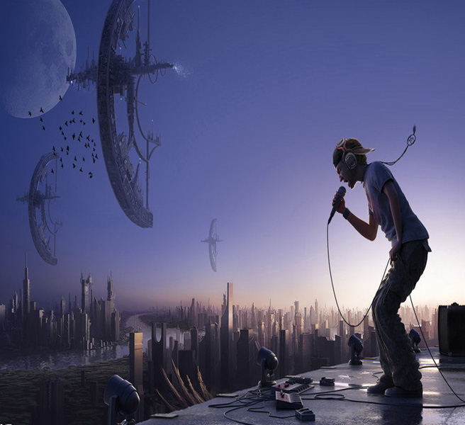
I can sing.

Slide 5
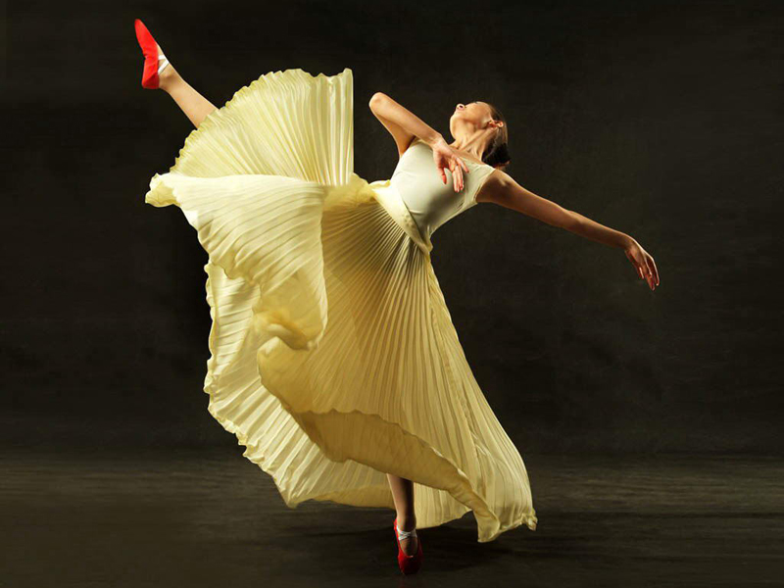
I can dance.

Slide 6
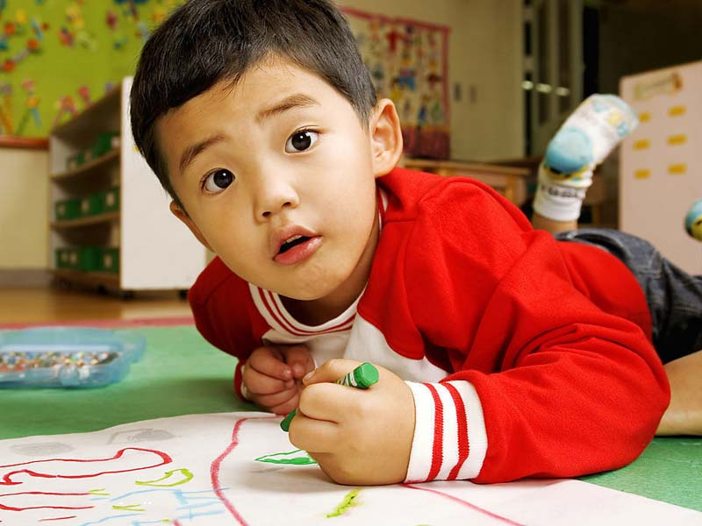
I can draw.

Slide 7

I can read.

Slide 8
Summary
I can...
我可以······

Slide 9
Thank you for watching!

